Slide 1



The Geospatial Knowledge Graph
From traditional UML defined datasets to Linked Data
Marco Brattinga (Ordina) and Pano Maria (Skemu)
Semantics 2019, September 11th
Notes:
Datum: 25-02-2019
Owner: Corp Comms
Info NL: Andere afbeeldingen voor deze cover-slide zijn te vinden op Connect via de volgende link: https://connect.ordina.nl/WieWatWaar/CentraleAfdelingen/CC/Pages/default.aspx
in het bestand: Cover slides.pptx

Slide 2
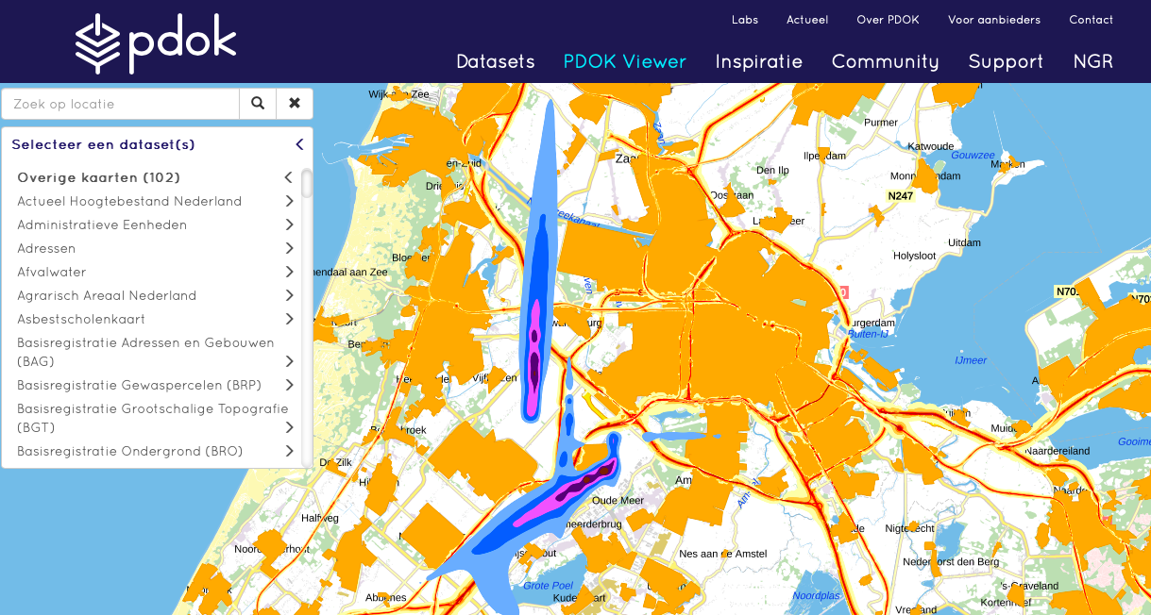
Geospatial data in the Netherlands
Notes:
Datum: 25-02-2019
Owner: Corp Comms
Standaard slide

Slide 3
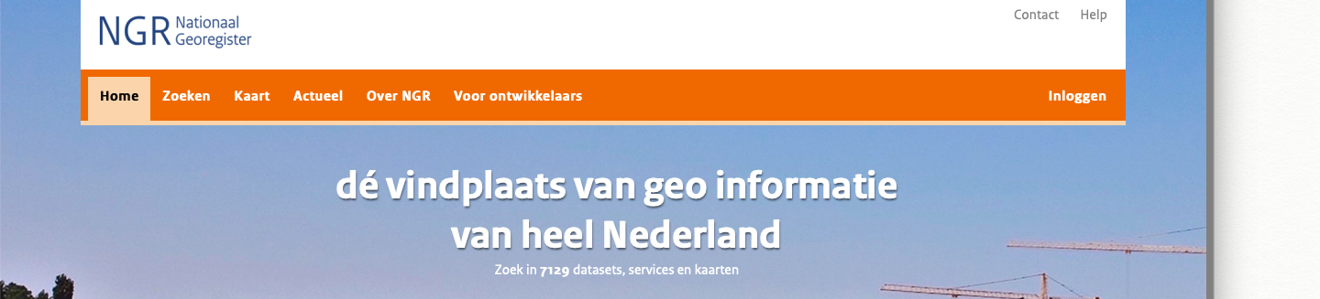
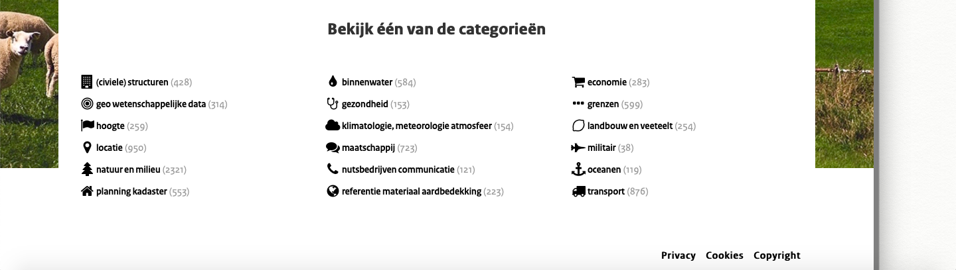
Geospatial data in the Netherlands
Notes:
Datum: 25-02-2019
Owner: Corp Comms
Standaard slide

Slide 4

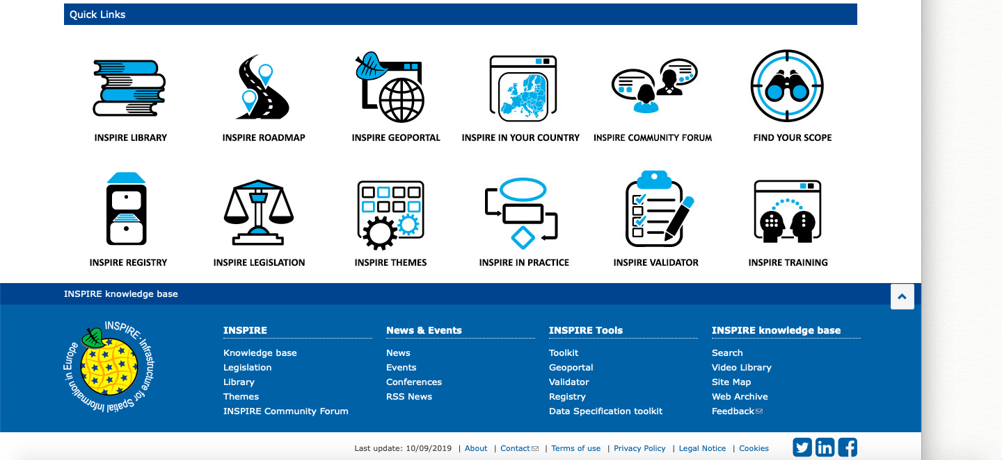
Geospatial data in the Netherlands Europe
Notes:
Datum: 25-02-2019
Owner: Corp Comms

Slide 5
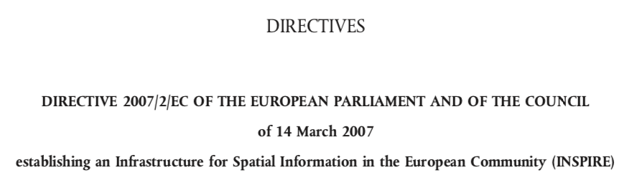
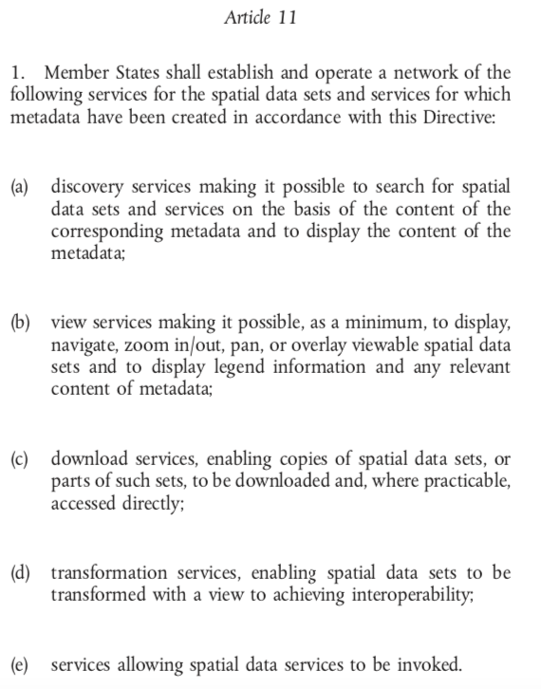
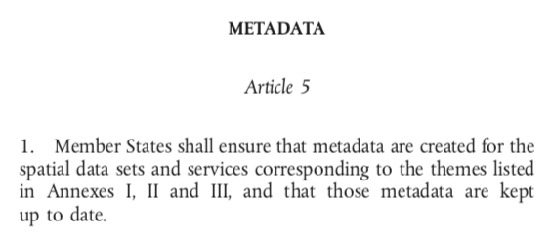
Geospatial data in the Netherlands Europe
Notes:
Datum: 25-02-2019
Owner: Corp Comms

Slide 6
The promising opportunity!
If so much geospatial data is available and…
It’s metadata is available;
The data itself is uniform…by law.
…it should be easy to use these datasets within a (RDF) knowledge graph!

Slide 7
So… what do we need?
Obtain a RDF model from the current metadata;
Use the RDF model to transform the original data to RDF;
Classify entities from different datasets under a common upper ontology;
Create links between entities that are more or less the “same”.

Slide 8
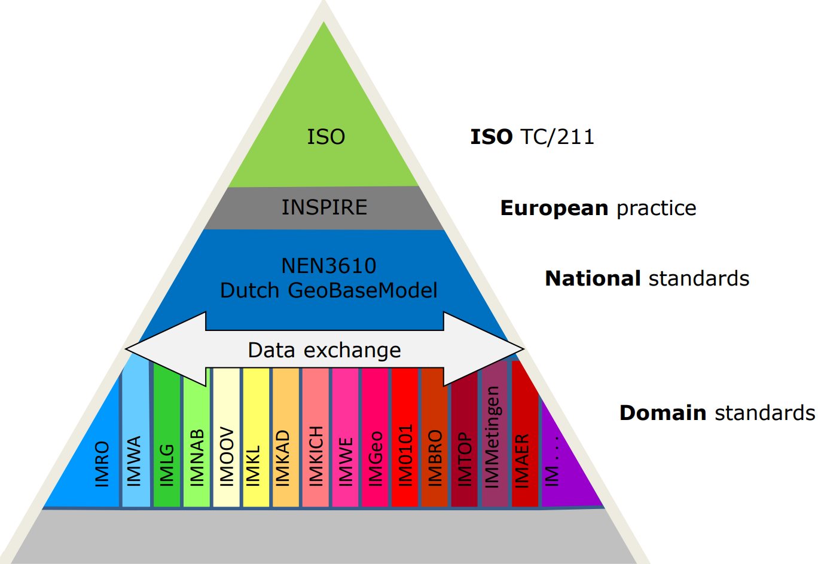
The current metadata model

Slide 9

NEN
NEN supports standardization process in the Netherlands;
Manages over 31000 standards accepted in the Netherlands;
International (ISO, IEC), European (EN) and national (NEN)
NEN 3610 – Basic schema for geo-information
Several iterations since 1995;
Aims to simplify exchange of geo-information between parties by defining mutual concepts to describe the world;
UML based.

Slide 10
UML
Notes:
Datum: 25-02-2019
Owner: Corp Comms

Slide 11
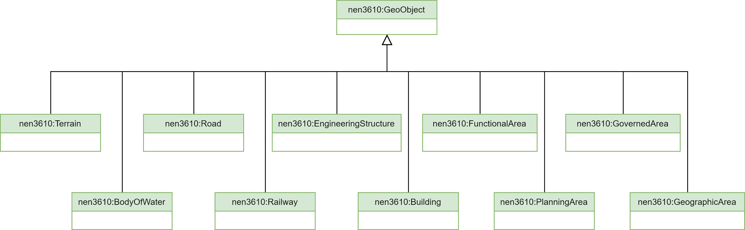
NEN 3610 Top model (in UML)

Slide 12
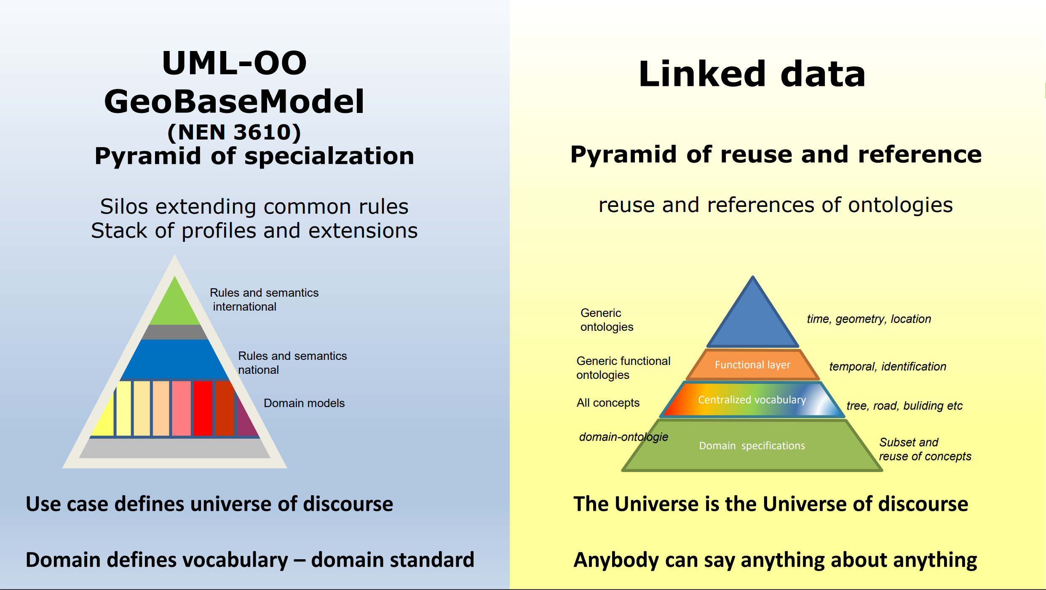
Added value for a Linked Data model – from the perspective of the geo guy

Slide 13
Step 1
obtaining the RDF model from the current metadata

Slide 14
Step 1: obtaining the RDF model from the current metadata

Slide 15
Step 1: obtaining the RDF model from the current metadata

Slide 16
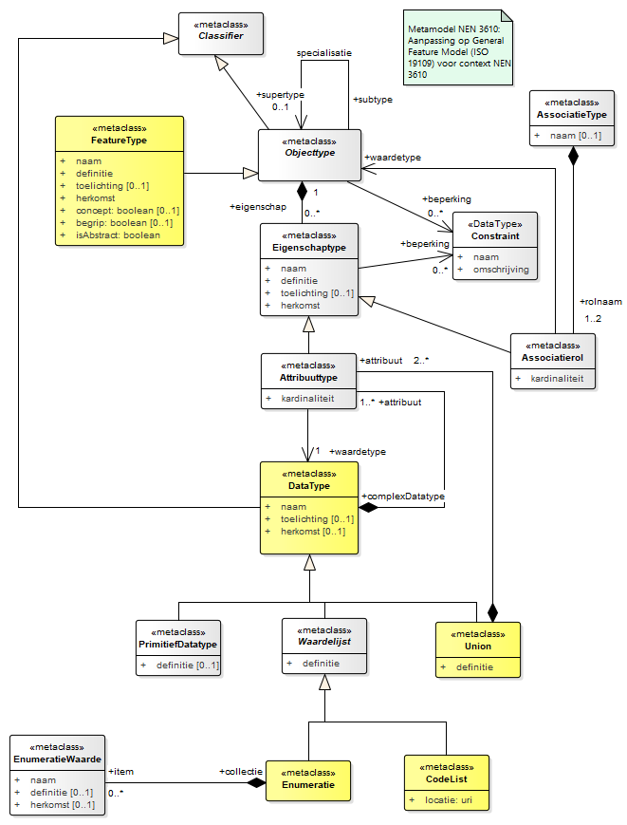
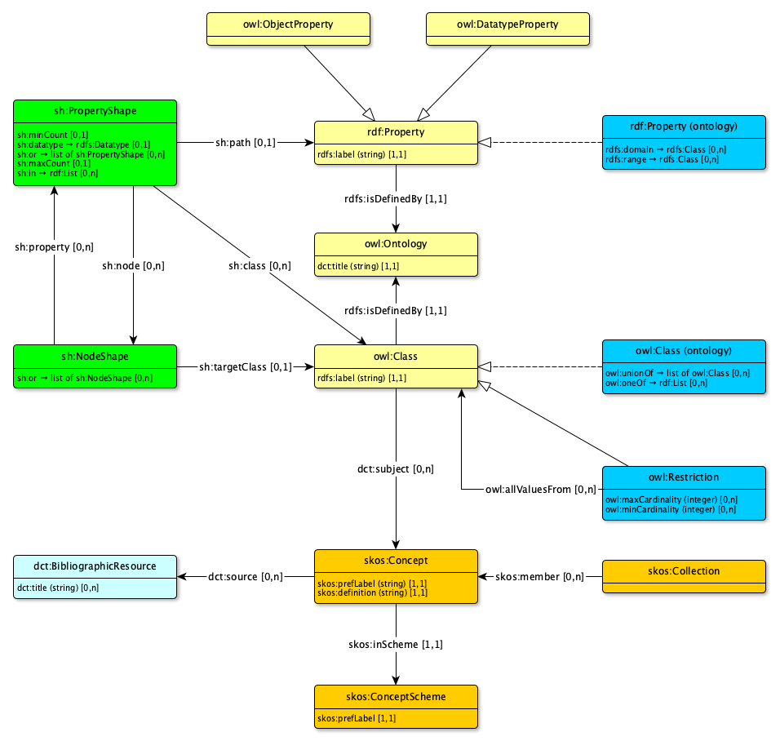
UML and RDF NEN 3610 metamodel

Slide 17
Building on existing work
ISO 19150-2: 2015 - Geographic information -- Ontology –
Part 2: Rules for developing ontologies in the Web Ontology Language (OWL)
INSPIRE - Guidelines for the RDF encoding of spatial data (ARE3NA)
OSLO² - Open standards for linked organizations
Enterprise Architect RDF Conversion Tool
MIM - Metamodel for Information Modeling
https://docs.geostandaarden.nl/mim/mim10

Slide 18
Challenges when transforming UML models to RDF
There is no 1 to 1 mapping possible between UML information models and “good” RDF ontologies for linked data
What is a “good” RDF ontology for linked data?
One that results in linkable data!
Recognizable/relatable things
Why is this a problem?
UML information models model data, RDF ontologies model semantics
UML information models have implicit semantics
UML information models often reflect some degree of denormalization
UML information models often model registrations of real world objects, whereas RDF ontologies model real world objects “directly”

Slide 19
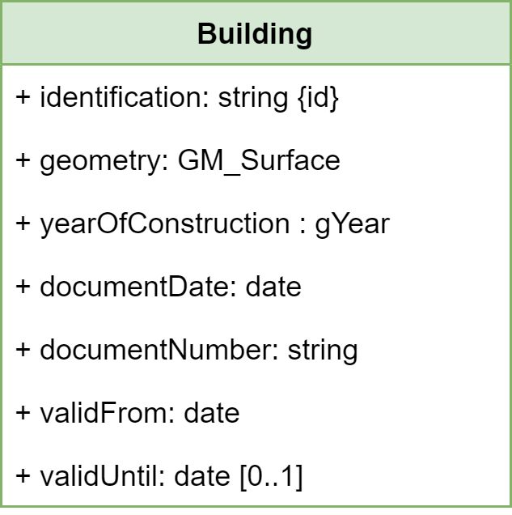
Example

Slide 20
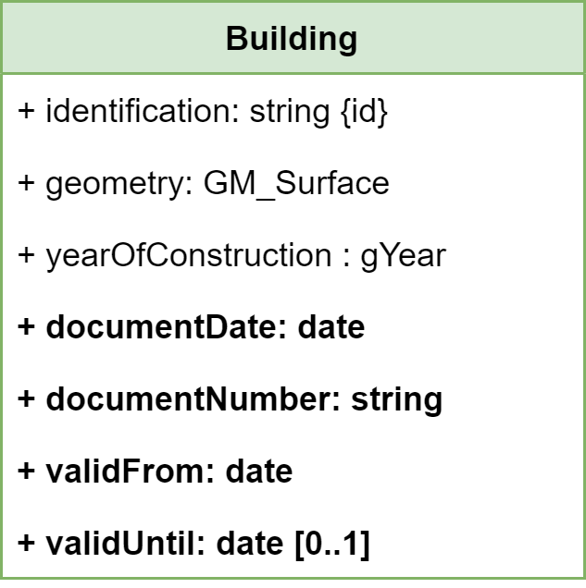
Example

Slide 21
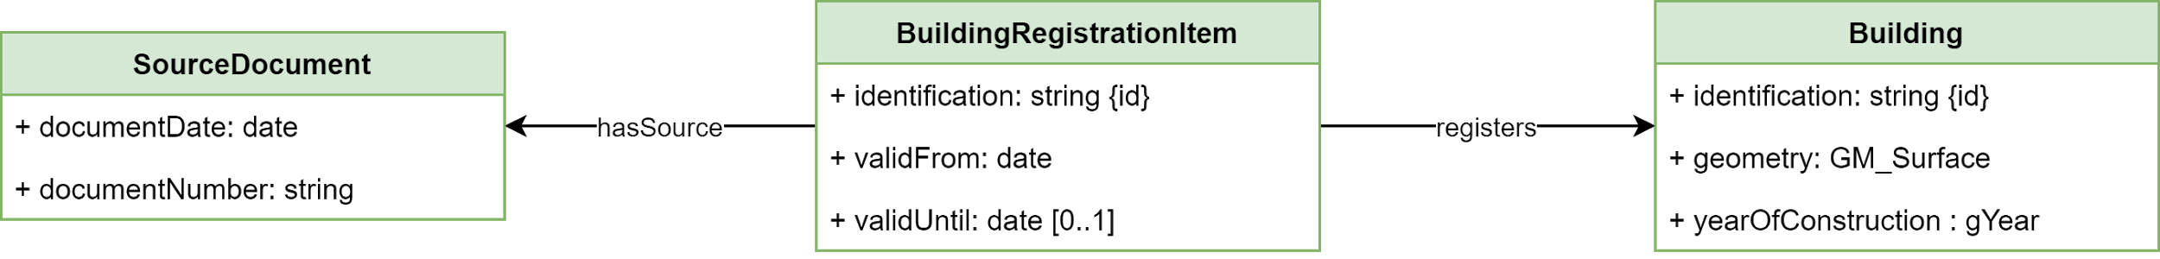
Example

Slide 22
Automatic translation of UML to RDF ontology?
It is possible to create a (syntactically) correct translation;
It is not possible to create a valid translation
Semantic information is (almost always) missing in the original model
Human interpretation is necessary.
Approach taken:
Standardised automatic translation as a starting point.

Slide 23
Step 2
creating a common upper ontology

Slide 24
Step 2: creating a common upper ontology
Not that hard: an upper ontology is already available in NEN 3610!
Only thing missing:
An RDF vocabulary;
Strict rules as part of the standard to use this RDF vocabulary.
Approach taken:
https://definities.geostandaarden.nl/def/nen3610#GeoObject
https://definities.geostandaarden.nl/def/nen3610#Water
etc…

Slide 25
Step 3
linking across information models

Slide 26
Step 3: linking across information models
Linking to related objects;
Linking objects that are more or less “the same”, handling sameness:
Exactly the same as;
Almost the same as;
Somewhat the same as, but not really
…
The NEN 3610 approach:
Using spatial relations for “sameness”!

Slide 27
Spatial relations

Slide 28
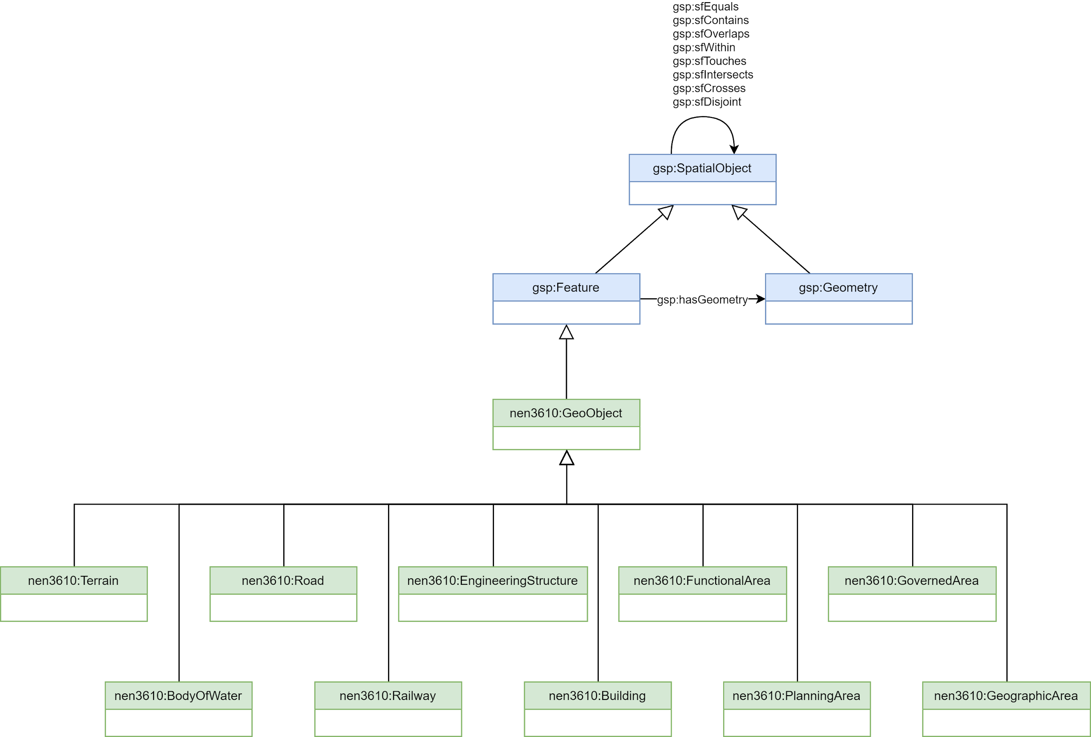
Spatial relations

Slide 29
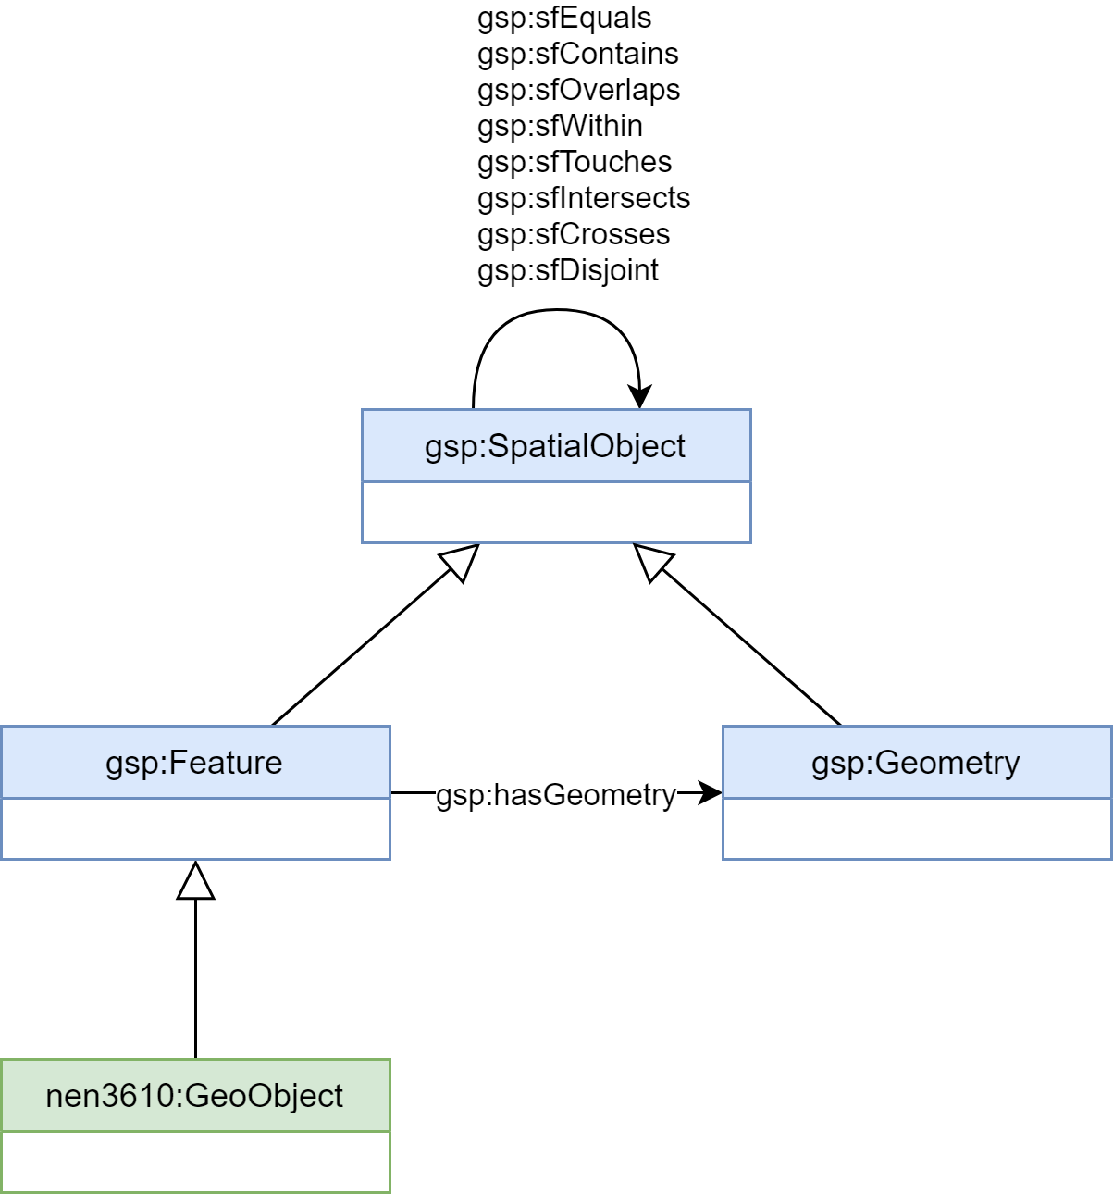
Spatial relations

Slide 30

Spatial relations

Slide 31
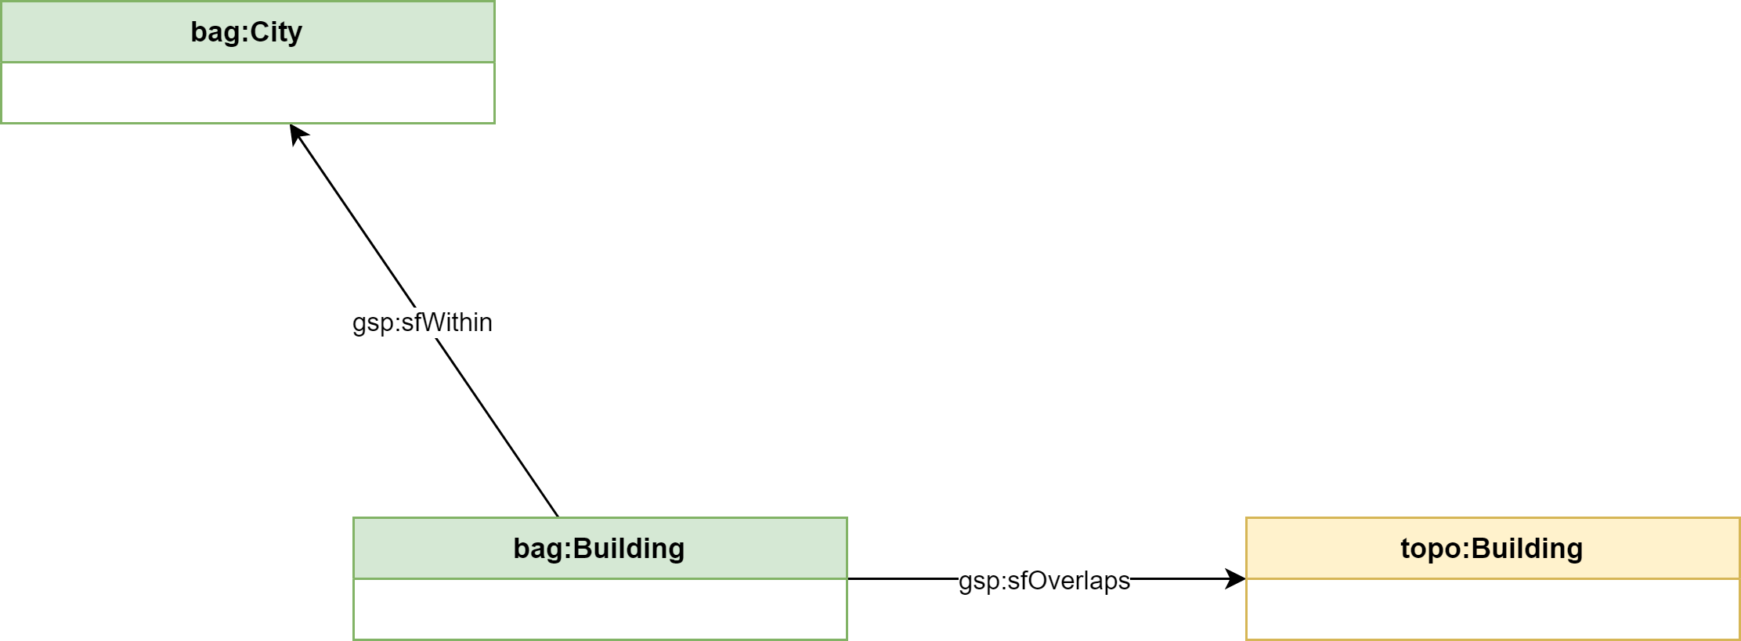
Spatial relations

Slide 32
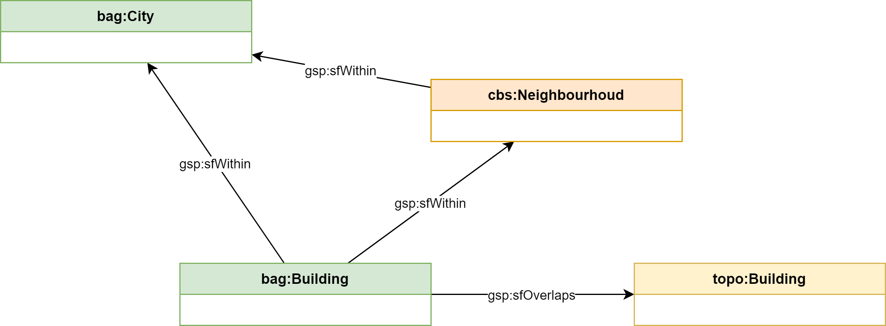
Spatial relations

Slide 33
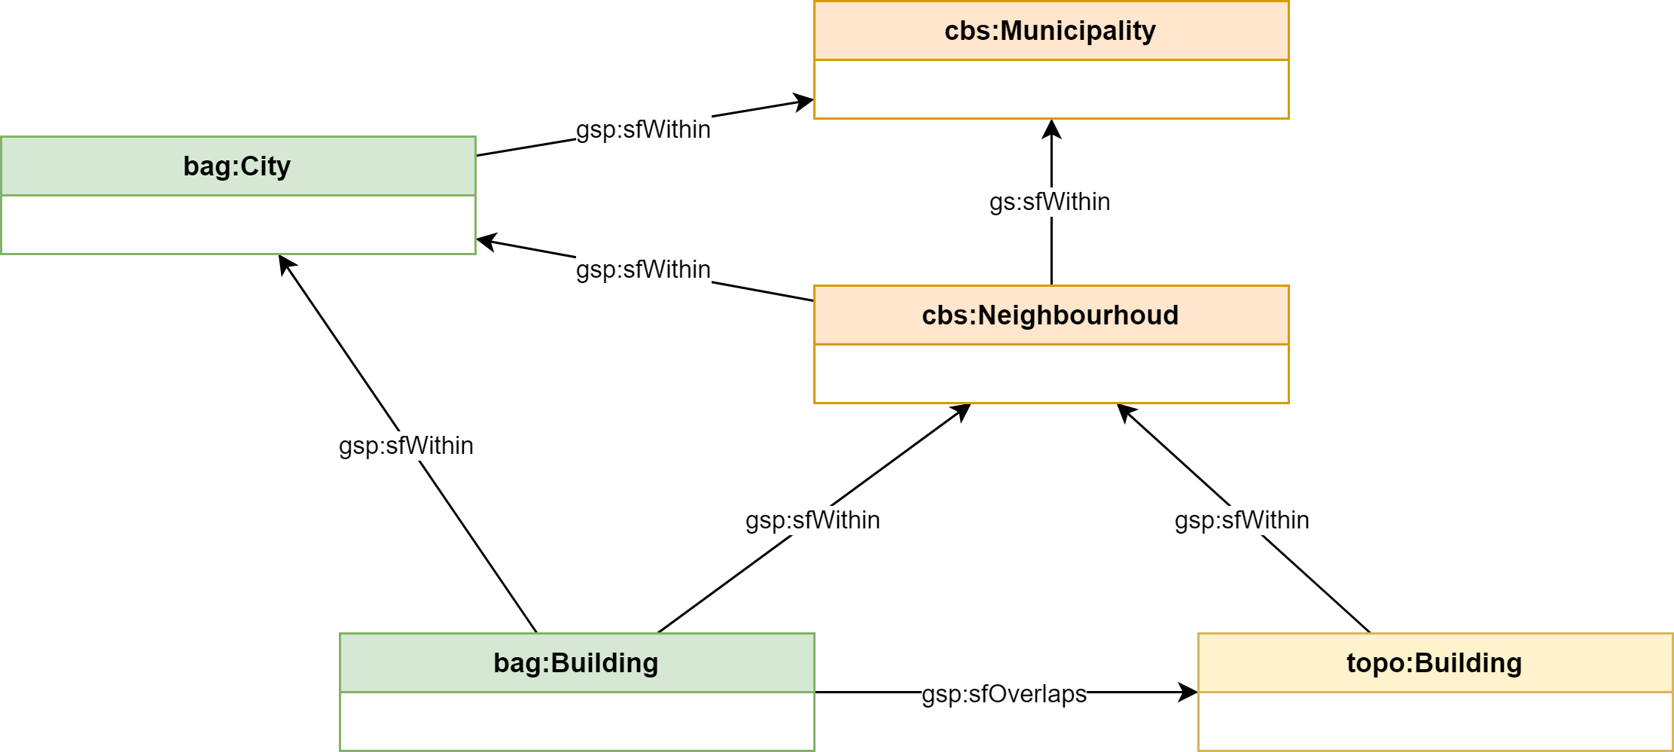
Spatial relations

Slide 34
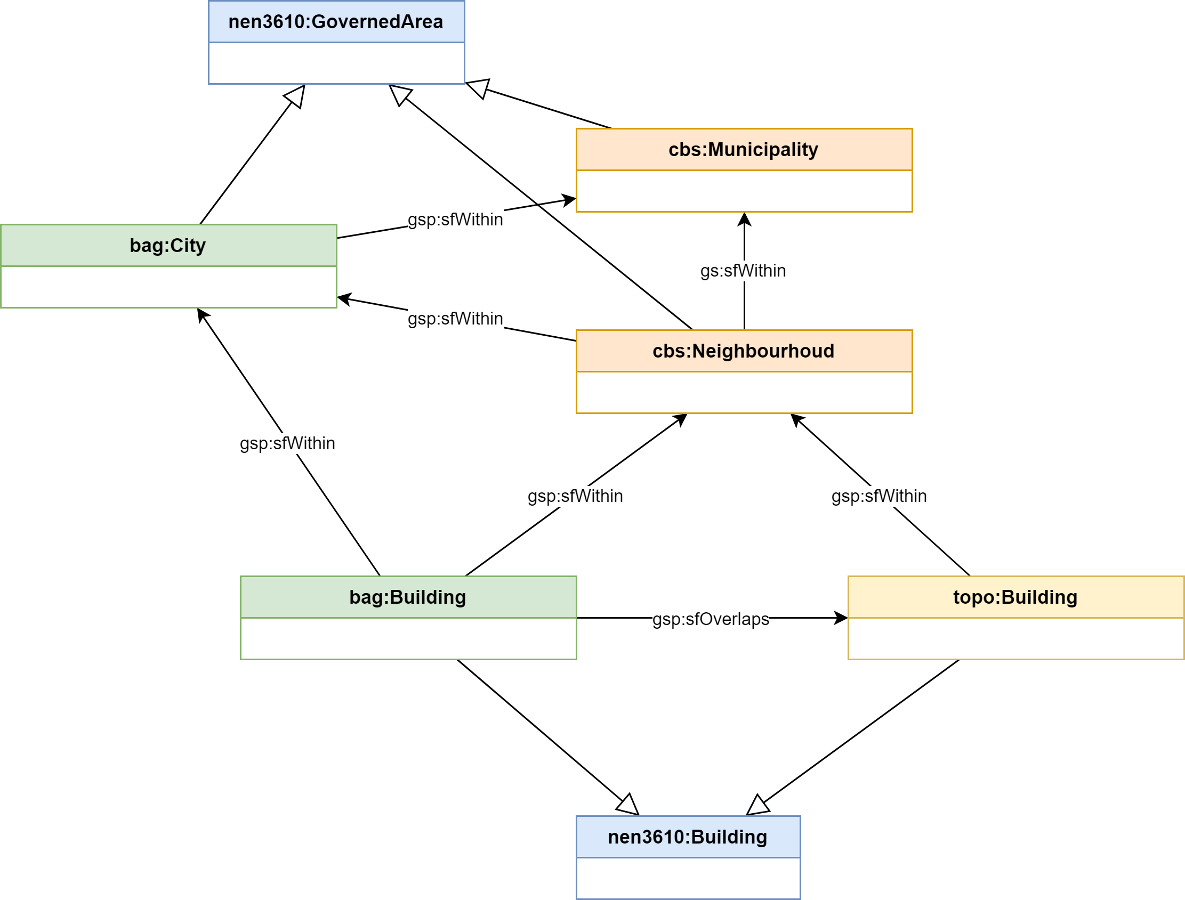
Spatial relations

Slide 35
Demonstration
The Geospatial Knowledge Graph

Slide 36
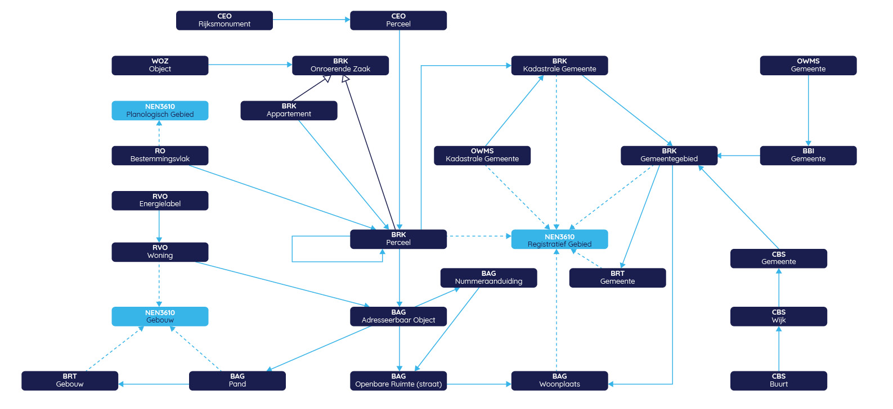
Demonstration of the Geospatial Knowledge Graph
Using NEN 3610 upper ontology to harmonise different classes;
Using standard geospatial relations to mitigate the “sameness” problem.

Slide 37
Visualisation
Federated SPARQL query
https://linkeddata.cultureelerfgoed.nl/sparql
https://data.labs.pdok.nl/migratie/sparql
Federated
Query
https://data.pdok.nl/sparql
https://betalinkeddata.cbs.nl/sparql
SPARQL
endpoint
SPARQL
endpoint
SPARQL
endpoint
SPARQL
endpoint
SPARQL
endpoint
BRK
BAG
BRT
CBS
IHR
RCE
WOZ
Gov
RVO
https://data.informatiehuisruimte.nl/sparql/ruimtelijke-plannen

Slide 38
Federated SPARQL query
CONSTRUCT {
<@SUBJECT@> ?p ?o.
?o rdfs:label ?olabel
}
WHERE {
{
SERVICE <http://linkeddata.cultureelerfgoed.nl/sparql> {
<@SUBJECT@> ?p ?o
OPTIONAL {?o rdfs:label ?olabel}
}
} UNION
{
SERVICE <https://data.pdok.nl/sparql> {
<@SUBJECT@> ?p ?o
OPTIONAL {?o rdfs:label ?olabel}
}
} UNION
{
SERVICE <https://data.labs.pdok.nl/migratie/sparql> {
<@SUBJECT@> ?p ?o
OPTIONAL {?o rdfs:label ?olabel}
}
} UNION
{
SERVICE <https://data.informatiehuisruimte.nl/sparql/ruimtelijke-plannen> {
<@SUBJECT@> ?p ?o
OPTIONAL {?o rdfs:label ?olabel}
}
} UNION
{
SERVICE <https://betalinkeddata.cbs.nl/sparql> {
<@SUBJECT@> ?p ?o
OPTIONAL {?o rdfs:label ?olabel}
}
}
}

Slide 39
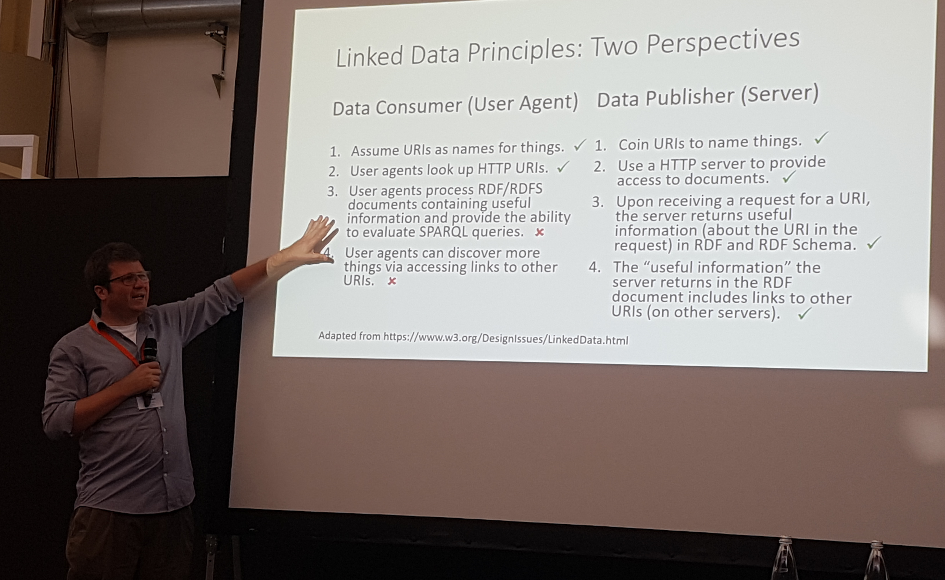
Federated SPARQL query – some problems
Not possible to traverse dereferenceable URI’s (“linked data” (!))
only SPARQL (select) is possible, so a SPARQL endpoint is needed;
Not possible to dynamically change the the endpoint URL;
Endpoint architecture is fixed, queries become very large;
Changes cannot be made “in the data”;
When one endpoint fails, the whole federated query fails
99,9% availablity is degrading very quickly (99,9 ^ 5 = 99,5)
A 404 or even a time-out might be interpreted as “no data found”, and used accordingly.
with kind permission, from:
Andreas Harth, Semantics 2019: From Representing Knowledge to representing behaviour

Slide 40

Wrap-up
Translating geospatial metadata to corresponding RDF models is possible and feasible, with some human help;
Translating geospatial data can be done automatically, if the model is available;
An standardised upper ontology for geospatial features is now available, directly derived from already used standards (NEN 3610);
Using spatial features for “sameness” works, creating them might be hard work;
Federated SPARQL queries work for traversing a knowledge graph, but SLA dependencies dictate more solutions.

Slide 41



Marco Brattinga Senior principal expert marco.brattinga@ordina.nl
Pano Maria
Information architect pano@skemu.com
@panomaria

